Slide 1
Pradeep Janakiraman
Vice President / Head
Offshore Services Delivery
Notes:
ZSL Global delivery - correction

Slide 2

Outline
Zylog – Brief Corporate Overview
Globalization Testing
What is it?
Why is it needed?
What does it involve?
How it is done?
Standard Steps
Sample tests
Pseudo Translation

Slide 3





Overview
Founded in 1995 Listed in India (NSE/BSE) Located in 13 countries and working with customers in 20 countries | USD 410 million (FY11) 50% of revenues from banking and telecom Headquartered in Edison, NJ 200+ professionals working on BFSI products | 3600 Professionals Dedicated Focus on Mobility Solutions 150+ mobile computing team ISO 9001 certified
Ranked 68 amongst the
Top 500 Indian IT companies
10 years of experience in developing industry solutions in mobile computing for Banking,
Financial services, Telecom, Logistics, Government and Healthcare
Cost effective solutions delivered through Zylog’s Global Delivery Model
Offshore Development Centres in Chennai, Bangalore and Hyderabad
Dedicated R&D Unit (IDEA Lab) for Value Added R&D Services to the ISVs and SPs

Slide 4
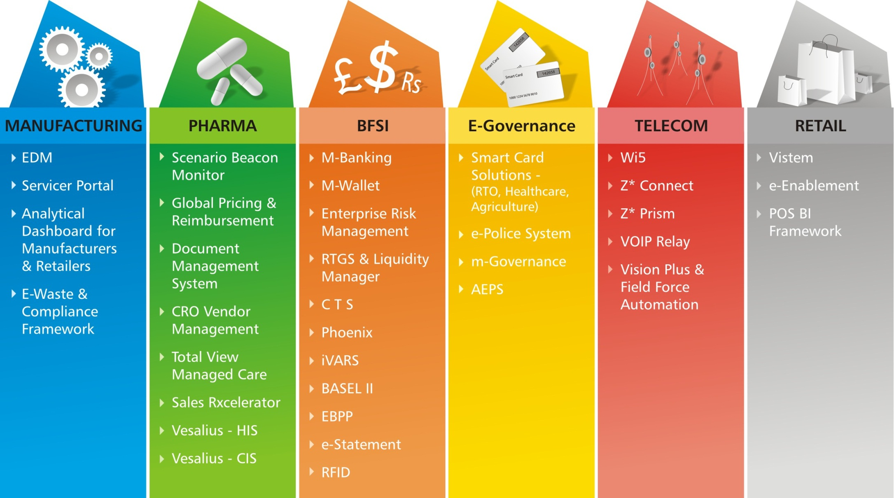
Portfolio of Solutions - Nutshell

Slide 6
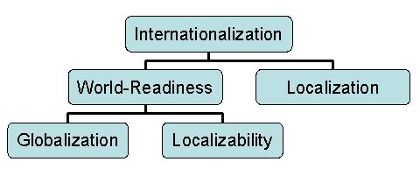
Globalized Software Development
Globalization:
The process of developing a program whose features and code design are not solely based on a single language or locale
Write once – (expect to) run everywhere
Ability to foresee issues that would arise in an international context
Key Concepts
World Readiness
Conscious design choices ground up
Natural Language Support, Unicode etc.
Localization
Translations & Customizations for a specific market

Slide 7
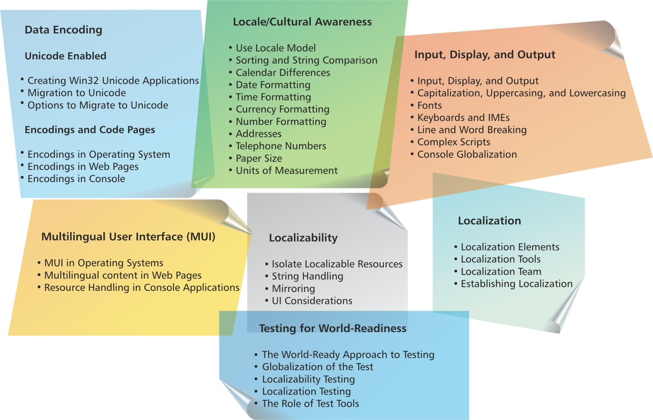
Globalization Step By Step

Slide 8
Text and Character Display Considerations
Computers assign numbers (code points) to represent letters.
100s of national and ISO standards in existence for computer encoding of modern language scripts.
Most legacy encodings are limited to 256 ( i.e., 28 ) code points.
This results in numerous problems.
Inadequate - 256 code points is not enough even for a single language,
Incompatible - code points representing letters in one national or ISO encoding will represent completely different letters in some other national or ISO encoding
LATIN "ù" in the Western European ISO-8859-1 becomes:
LATIN "ů" in the Central and Eastern European ISO-8859-2 encoding,
GREEK SMALL LETTER OMEGA "ω" in ISO-8859-7,
HEBREW LETTER SHIN "ש" in ISO-8859-8
Could easily result in garbled emails, web pages, or databases!

Slide 9
Localization Considerations
Calendar differences
Long, Short, year and month formats
Abbreviations and full names of months
Native name of calendar
Date / Time formatting
Tuesday, October 12, 1954
Spanish martes 12 de octubre de 1954
Currency formatting
Symbol, placement, -ve amt display
Number formatting
1,025 in U.S, 1.025 in Germany, In sweden separator is a space
-ve numbers : 527 -; -527, (527)
Addresses
Canada “M5R 3H5”; France “93200”, elsewhere “F-92300”
Taiwan considered as region by some nations, others as country
Telephone numbers
China – 1234 5678; France 01-23-45-67-89; Singapore 123 4567 (01) 234-5678
UK 01234 567890
Units
Distance, Weights, Volume, Temperature, Area etc.
Fonts
Line & Word breaks

Slide 10
Locale Considerations
Important to design s/w that is both locale and culture aware
Locales involves support for a group of languages
Central European (polish, romanian) or East Asian (japanese, korean, chinese)
System locale
determines which code page is used on the system by default on o/s to convert text data whenever dealing with legacy non-Unicode applications
User locale
determines which default settings a user wants for formatting dates, times, currency, and large numbers.
Input locale
Describes a language user wants to enter into an application and the method of input (e.g: eyboard type – English, Fench, etc.

Slide 11
World Readiness Testing
Internationalization of products is a continuous balancing act
Not a trivial task, cannot be taken for granted
The Level and effort is always grossly underestimated
The Level of effort required for creating a world-ready applications varies between markets/languages
Requires a methodical QA approach to certify s/w

Slide 12
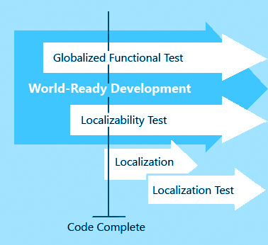
Globalization Test Strategy
“Globalize” the test cases
modifying legacy test cases to verify functionality is globalized
Ensuring Unicode text can be handled successfully
Ensuring Correct encodings are selected for text conversions
Ensuring Culture specific settings are considered
Prioritize the components to be tested
Some are more likely to have issues than others
Choose components that extensively handle text
Components that have many configurable parameters
Choose the Test Platform
Ability to vary language and regional settings (Win-XP)
Set up the Test Environment
Globalize the Test data

Slide 13
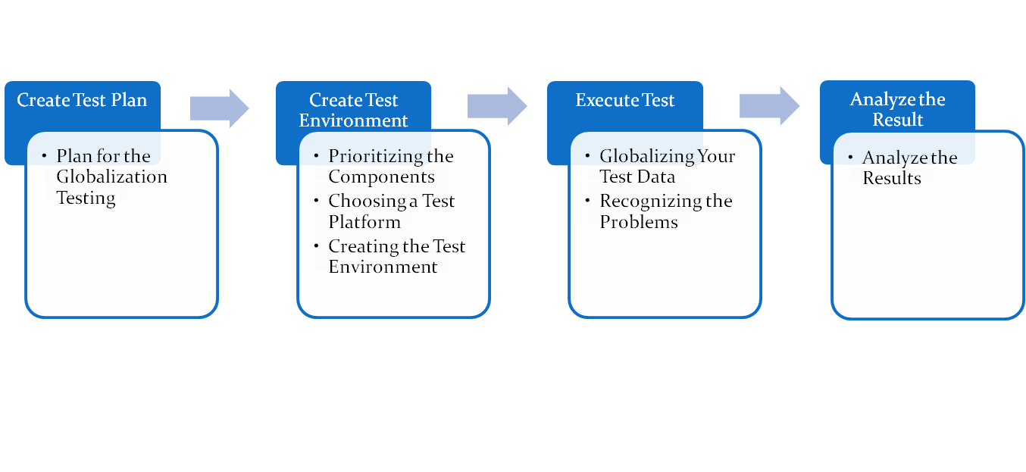

Globalization of the Test

Slide 14
Tests for Deployment & General Functionality
Application setup under different language environments
to check for o/s UI language and Application language mismatches and other system & user locales etc.
Verifying General functionality with various system and user-locale settings
to eliminate unwanted locale dependencies
Uninstalling the application with different locale settings
ensure that system-locale and user-locale settings are different from those at app installation

Slide 15
Tests for Text Handling
Text Input checks using different input locales
Entering text switching between different keyboard layours
Verifying ability to accept multi-lingual input
Clipboard operation checks
Ensure multi-lingual text can be copied to & from keyboard
Ensure cut and paste does not pose limitations
Verifying alignment of multilingual output
Ensuring text conversions between encodings do not cause buffer overflows, memory leaks etc.

Slide 16
Tests for Locale Awareness
Check for adherence to
Menus, Messages, Captions are displayed properly
Also messages in Event log, Error Messages, Tool tips etc.
AM/ PM symbols
Different time & date formats
+ve and –ve number formats
Currency symbols hardcodings
Verify that applications are not affected if the size of the shell font or screen resolution is changed.
Non-Textual resources (such as images and sounds) that must be localized, ensure clear rules and requirements are defined for the localization.

Slide 17
Pseudo Translation
What is Pseudo Translation?
Testing a product’s localizability, i.e: whether it can be successfully localized or translated.
Converts text (typically English ASCII text) to non-random non-ASCII text algorithmically
What is it Good for ?
Testing localizability
Detecting hard-coded strings
Detecting problems with resources and resource formats
Detecting layout problems emanating from length/height/font changes
Is automated
can be applied to a source text much more quickly
produces results that are predictable following a particular pattern.

Slide 18
Types of Pseudo-Translation
Algorithmic Translation
Maps code points using “ASCII Math
Produces strings that are visibly “ASCII” but structurally multi-byte (in SJIS or UTF-8 for example)
Mapped Translation
Maps code points using a table (• e -> é )
Random Translation
Maps code points at random
Replaces one character with different characters so that the same string is rarely the same twice.
Simulated Encoding
Generate encoding-based test string
Replace an ASCII text buffer with a similarly sized and structured text in a given encoding (or using a given character repertoire).
Auto-Magical
Use a machine translation Web service or tool to make text in a given language

Slide 19
References
http://www.inter-locale.com
http://www.testingmentor.com
http://quality-assurance-software-testing.blogspot.com/2005/09/localization-testing.html
http://msdn.microsoft.com/en-us/goglobal/bb892890
http://msdn.microsoft.com/en-us/library/aa292086(v=vs.71).aspx
http://www.acclaro.com/software-globalization-testing-tips
http://www.psqtconference.com/2004east/tracks/Tuesday/PSQTglob2.pdf

Slide 20


Slide 21
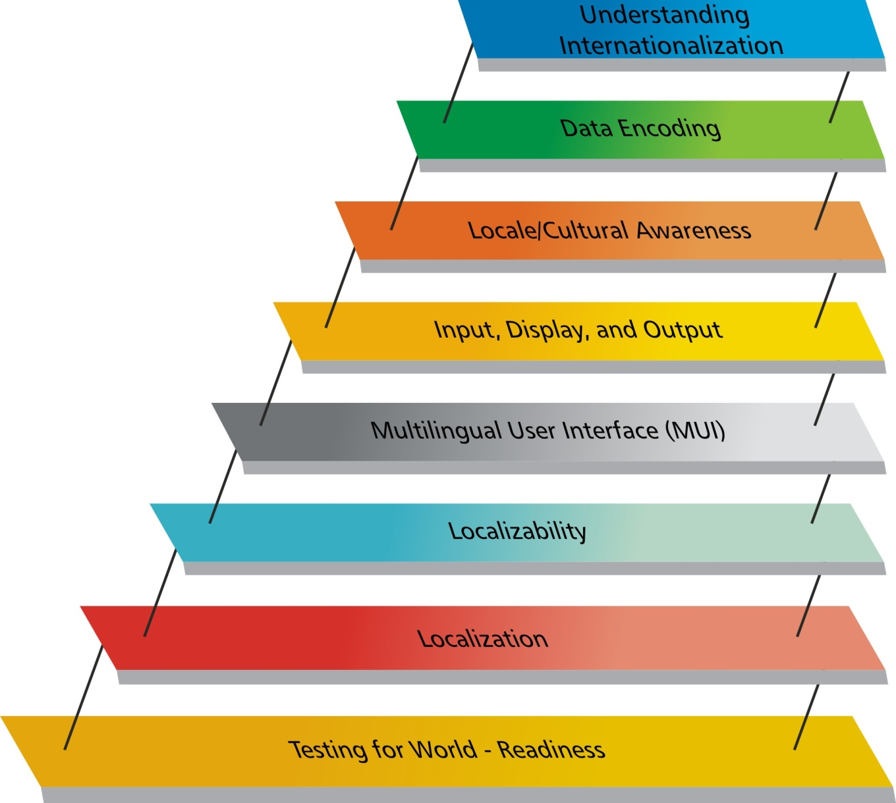
Globalization Step-by-Step

Slide 22
World Readiness Testing
Internationalization of products is a continuous balancing act
Word readiness is not an easy task, cannot be taken for granted
The Level and effort is always grossly underestimated
The Level of effort required for creating a world-ready applications varies between markets/languages
Requires a methodical QA approach to certify s/w
Key Considerations
Data Encoding
Locale/Cultural Awareness
Input, Display, and Output
Multilingual User Interface (MUI)
Localizability
Localization
Testing for World-Readiness

Slide 23
The World-Ready Approach to Testing

